Slide 1
Martley CE Primary School
Curriculum Intent
Click on a subject for more information
Religious Education
Maths
English
Science
Geography
PSHCE
Physical
Education
History
Computing
French
Art,
Design and Technology
Music

Slide 2

Art
To provide all pupils with opportunities to develop their knowledge and skills in using a wide range of materials.
To experience drawing, painting, printing, collage, textiles, sculpture and digital art.
To provide opportunities for pupils to express themselves through art and to encourage them to take risks and reflect on the work of others and themselves.
To engage, inspire and challenge pupils to create their own works of art.
To know about inspirational people across all aspects of art and their contribution to history and culture.
To be able to evaluate and analyse their own work, and the work of others, using the language of art, craft and design.

Slide 3

Computing
To develop computational thinking through using a range of technologies.
Pupils will understand how to effectively and safely engage in an increasingly digital world.
To introduce pupils to a range of technology and develop their understanding how these are used in society and the ‘world of work’.
Pupils will gain an understanding of algorithms, data representation and logic and begin to analyse problems in computational terms.
Pupils will be able to communicate ideas successfully through digital means across all areas of the curriculum and be able to utilise these skills outside of school life.

Slide 4
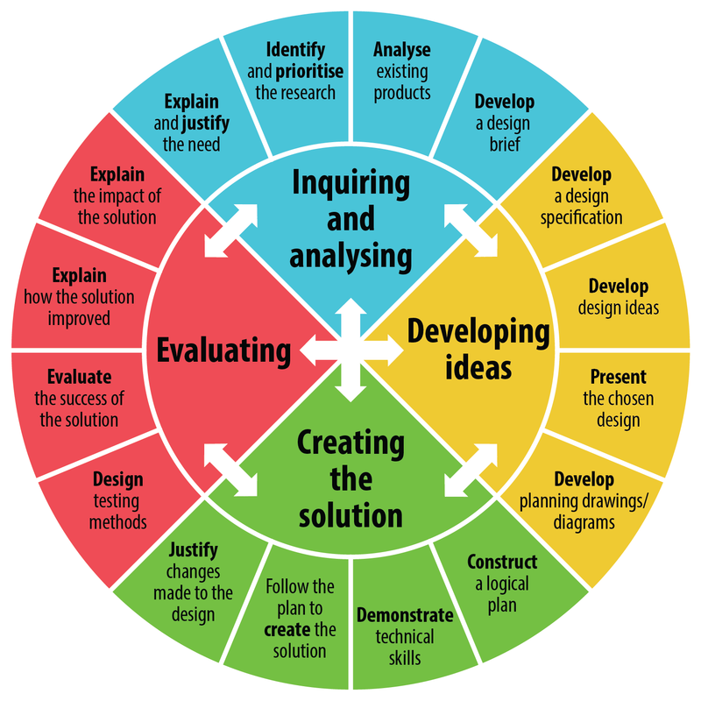
Design and Technology
To inspire children and promote and develop practical, meaningful skills.
To help children develop an understanding of the skills needed in an increasingly technological world and foster their confidence in using these skills.
To guide children to analyse, evaluate, design, make and reflect through a range of different and progressive projects.
To apply skills learned in other subjects such as maths, art and science in a practical context.
To gain an understanding of the impact of Design and Technology in the modern world and through periods of history.
To understand the principles of nutrition and diet including learning basic cooking skills.

Slide 5
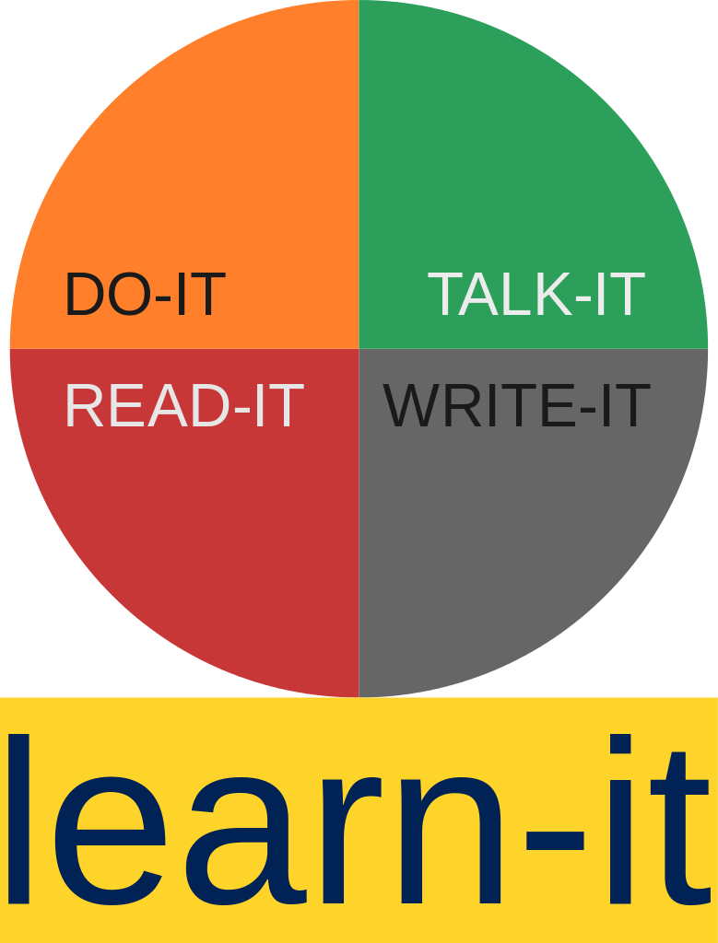
English
To enable every pupil to speak and communicate effectively amongst their peers and within society.
To develop the skills needed, including decoding, to develop reading and foster a lifelong love of reading.
To develop comprehension skills through using a wide variety of texts so that pupils gain an understanding of what they read.
To extend pupils’ range of vocabulary, their understanding and use of such vocabulary in their written work.
To develop the ‘tools’ of writing: accurate spelling and grammar; a clear and fluent handwriting style.
To provide opportunities for children to write for purpose and to understand the power of the written and spoken word.
To develop pupils’ understanding and awareness of different cultures through using a diverse range of texts.

Slide 6

Languages (French)
To provide opportunities to communicate confidently with others in another language.
To help understand their place in a multi-cultural society and to foster a curiosity about our world and the people within it.
To develop the skills and foundations needed to explore further language acquisition.
To provide opportunities for pupils to communicate for practical purposes and experience texts in the original language.
To develop cross-curricular links such as developing number knowledge in a different language.

Slide 7
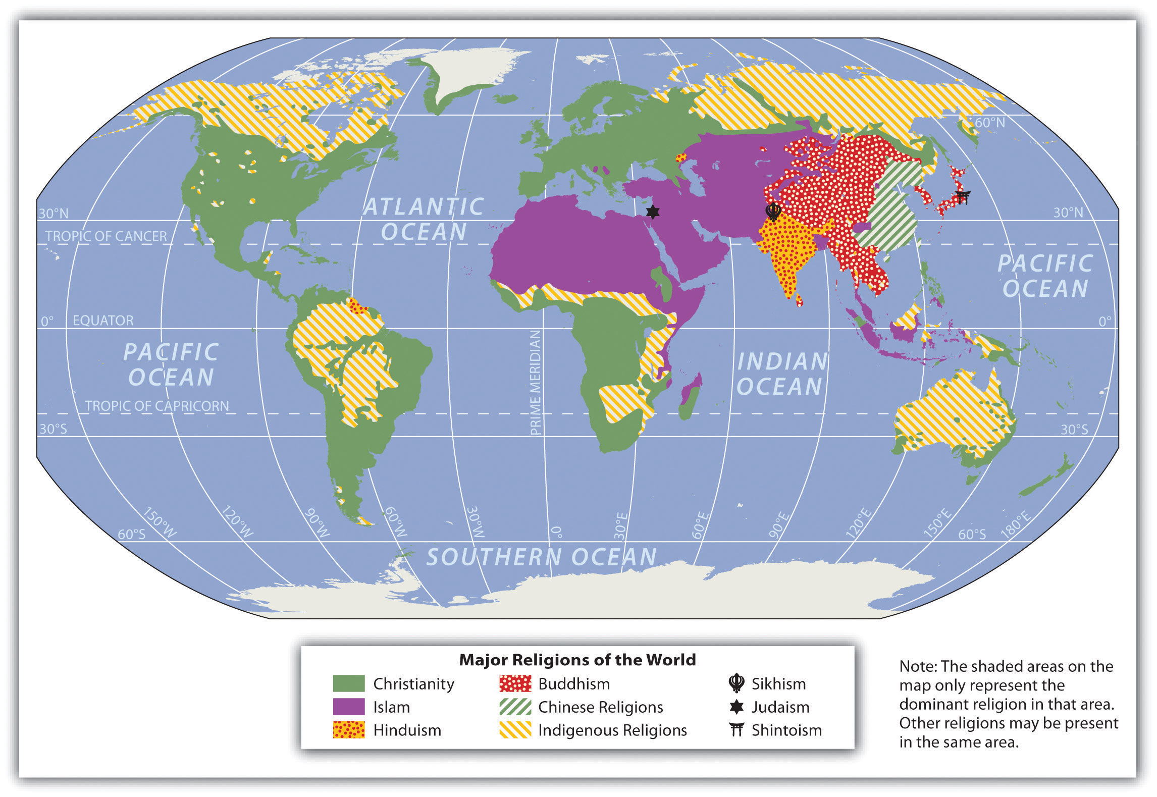
Geography
To foster a lifelong curiosity and sense of the world; its physical nature, cultures and the people within it.
To know about and investigate a range of diverse places, people and resources including both natural and human environments.
To improve pupils’ knowledge of a range of maps and their ability to interpret what maps are telling them.
Pupils will develop an appreciation and understanding of their local area and how natural causes and humans have influenced the area.

Slide 8

History
To fire curiosity about the past in Britain and the wider world.
To develop a chronological narrative of the past.
To develop a coherent knowledge and understanding of Britain in the past, including local history.
To enable pupils to develop historical and transferable skills such as empathy, critical thinking, the ability to question and develop perspective.
To be able to identify and use primary and secondary sources to support historical questioning.
To understand the concept of change and a sense of what has changed and why.

Slide 9

Maths
To develop a deep understanding of number
To foster of love of maths and the willingness to welcome challenge.
To develop a wide range of mathematical vocabulary which pupils understand and use in context.
Pupils will master the necessary maths skills needed to problem solve, to explore mathematical ideas and to apply this knowledge rapidly and accurately across the curriculum and in life.
Pupils will encounter and use concrete, pictorial and abstract concepts in order to access and explore a range of mathematical and real life problems.

Slide 10

Music
To possess a curiosity and appreciation of different types of music.
Every child should have the opportunity to develop their musical potential.
Children gain an understanding of music through playing instruments, singing, listening, evaluating music and composing across a range of musical genres and periods of history.
To ensure that children respect and understand the importance of music in the wider community and within themselves.
To encourage and foster a lifelong interest in performing and listening to music.
To understand and use a range of musical vocabulary.
Pupils should feel confident in expressing feelings and thoughts through both listening to and participating in music.

Slide 11
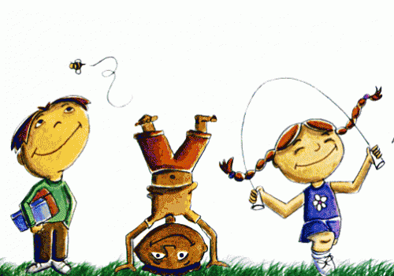
Physical Education
For pupils to develop positive attitudes towards health and activity and to enable them to lead healthy and active lives.
To develop pupils knowledge, skills and vocabulary through a wide range of physical and sporting activities.
To enable pupils to take part in a wide range of sports and physical activities that develop character and embed values such as respect, honesty, fairness and resilience.
PE will promote healthy lifestyle choices, positive mindset, collaboration and an awareness of a healthy and balanced diet.
We will offer pupils opportunities to develop as leaders within physical activities and sports to develop their character and empathy with others.
To foster and develop links with sporting clubs outside school in order to develop lifelong participation and appreciation of sport.

Slide 12
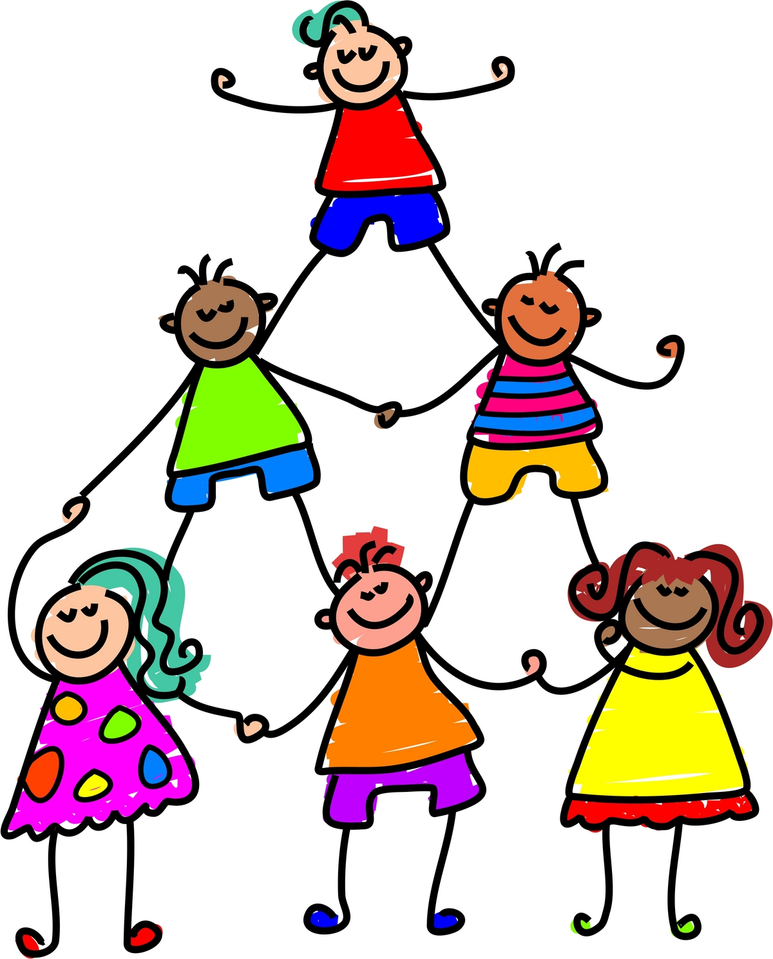
PSHEC
(Personal, Social, Health Education and Citizenship)
Pupils will be healthy, responsible, active and independent members of the school community and the wider society.
To guide pupils to a breadth of experiences which enrich and enhance their life skills.
To give pupils the confidence to discuss and face many of the moral, social and cultural issues that are part of growing up and becoming an adult.
To help children understand how society functions, develop an awareness of how rules and laws are formed and their part in these processes.
To provide opportunities to develop pupils’ understanding of healthy relationships, mental well-being and physical health.

Slide 13

Religious Education
Pupils will be able to engage with religious and non-religious ideas inclusively, respectfully and thoughtfully.
Pupils will be able to express their own ideas about religion including their own beliefs.
Pupils will know and understand a range of religions, including their beliefs and practices, locally and globally.
Pupils will recognise similarities and differences across religions and develop a tolerance and understanding of the beliefs of others.
Pupils will have a deeper understanding of Christianity alongside a respect and understanding of other faiths and of people with no faith.
Pupils discover, explore and consider different ways to answer questions about human identity, meaning and value.

Slide 14

Science
To develop an understanding of scientific processes and how science impacts the world around them.
To acquire and use a range of skills such as questioning, problem solving, reasoning, observing, planning and investigating.
To equip pupils with the skills and knowledge to think and work scientifically.
To raise pupils’ awareness of scientists from history and modern society.
To gain an understanding of the uses and implications of science today and in the future.

